Slide 1
FALL
SEP - DEC
WINTER
JAN - APR
SPRING
MAY - JUN
Block 1 (4 weeks)
511 - Programming for Data Science
521 - Computing Platforms for Data Science
542 - Communication and Argumentation
551 - Descriptive Statistics and Probability for Data Science
Block 4 (4 weeks)
562 - Regression II
573 - Feature and Model Selection
572 - Supervised Learning II
522 - Data Science Workflows
Block 2 (4 weeks)
523 - Data Wrangling
531 - Data Visualization I
512 - Algorithms and Data Structures
552 - Statistical Inference and Computation I
Block 5 (4 weeks)
563 - Unsupervised Learning
553 - Statistical Inference and Computation II
524 - Collaborative Software Development
574 - Spatial and Temporal Models
CAPSTONE
PROJECT
(8 weeks)
Block 3 (4 weeks)
561 - Regression I
532 - Data Visualization II
571 - Supervised Learning I
513 - Databases and Data Retrieval
Block 6 (4 weeks)
575 - Advanced Machine Learning
541 - Privacy, Ethics and Security
554 - Experimentation and Causal Inference
525 - Web and Cloud Computing

Slide 2
FALL
SEP - DEC
WINTER
JAN - APR
SPRING
MAY - JUN
Block 1 (4 weeks)
511 - Programming for Data Science
521 - Computing Platforms for Data Science
542 - Communication and Argumentation
551 - Descriptive Statistics and Probability for Data Science
Block 4 (4 weeks)
562 - Regression II
573 - Feature and Model Selection
572 - Supervised Learning II
522 - Data Science Workflows
Block 2 (4 weeks)
523 - Data Wrangling
531 - Data Visualization I
512 - Algorithms and Data Structures
552 - Statistical Inference and Computation I
Block 5 (4 weeks)
563 - Unsupervised Learning
553 - Statistical Inference and Computation II
524 - Collaborative Software Development
574 - Spatial and Temporal Models
CAPSTONE
PROJECT
(8 weeks)
Block 3 (4 weeks)
561 - Regression I
532 - Data Visualization II
571 - Supervised Learning I
513 - Databases and Data Retrieval
Block 6 (4 weeks)
575 - Advanced Machine Learning
541 - Privacy, Ethics and Security
554 - Experimentation and Causal Inference
525 - Web and Cloud Computing
Languages used: R, Python, R & Python

Slide 3

reticulate
GNU Make

Slide 4
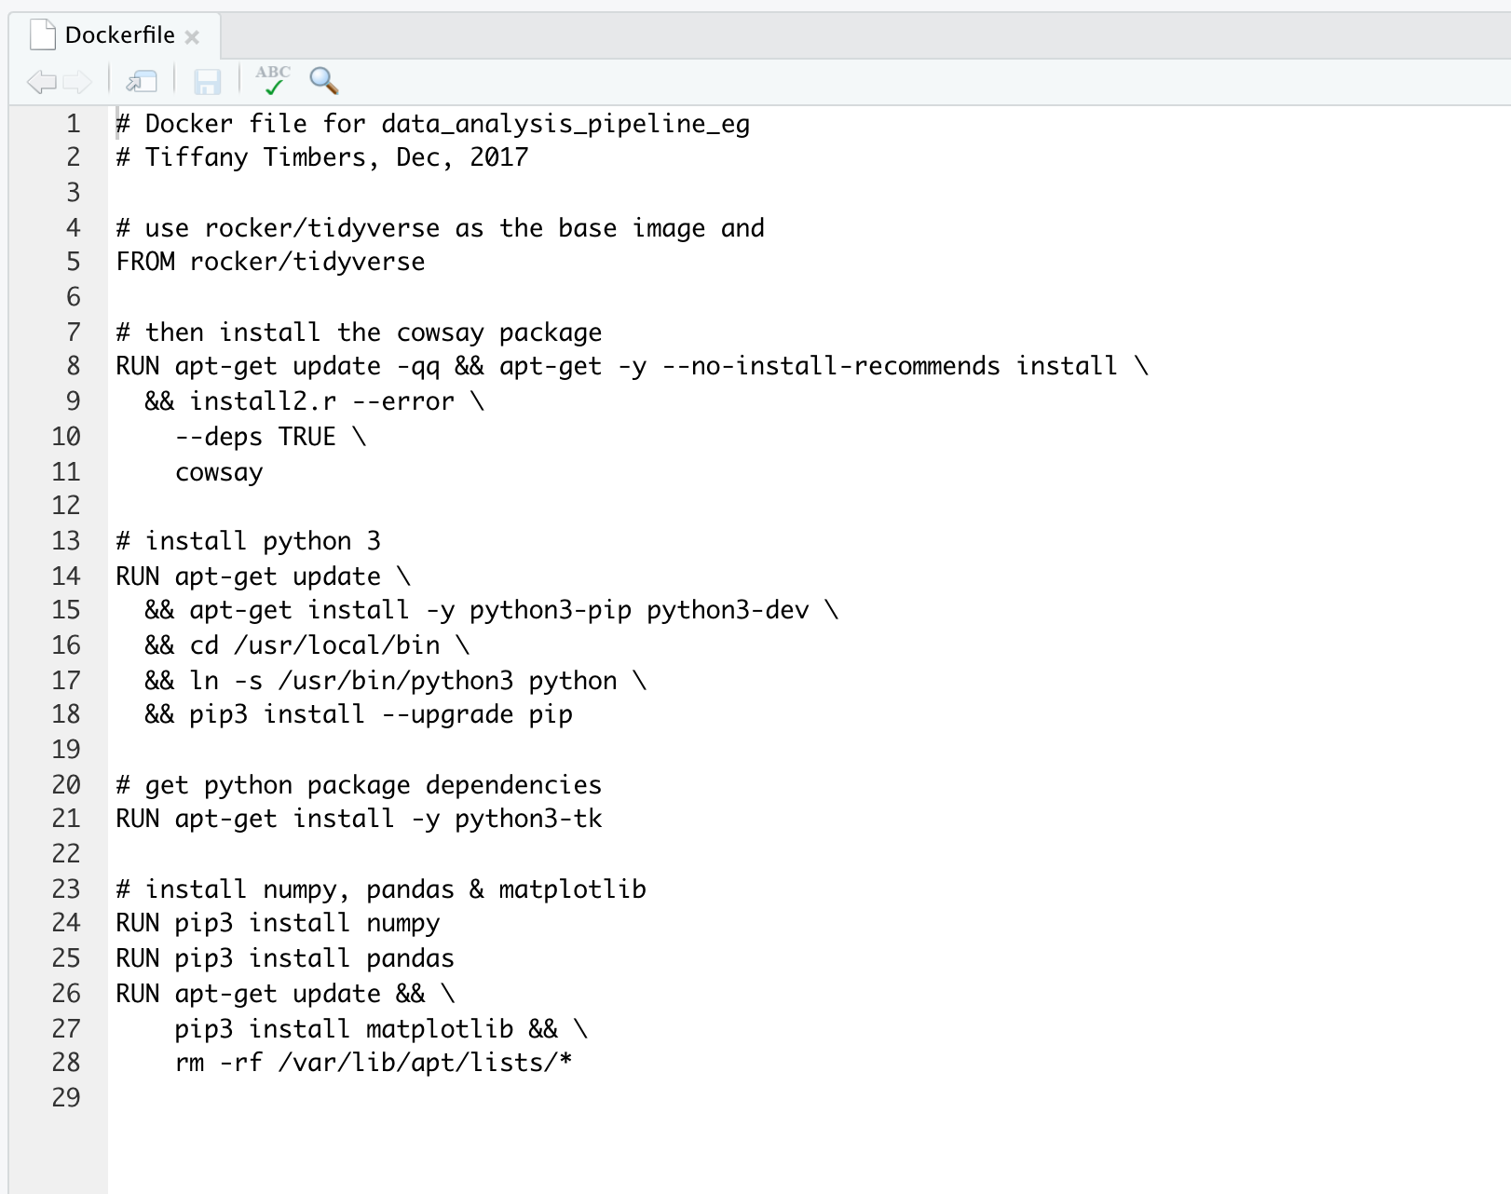
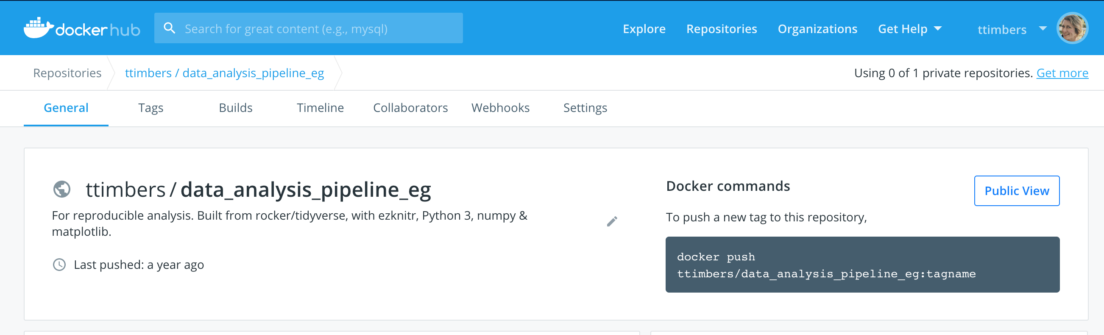

Slide 5
